Slide 1
MoMo Talent 2024 Data Analytics Trainee
Case Study
Candidate name: Từ Trương Tuấn Kiệt
Candidate password: mt169nq48r
Date: 16/06/2024

Slide 2
Part A: Data Processing
(10 points)

Slide 3
Part A
Question | Answer | Excel file data location (sheet/cell)
1) Total revenue in January 2020: | 1,409,827 VNĐ | Q1
2) Most profitable month: | September | Q2
3) Day of week (most money): | Thursday | Q3
3) Day of week (least money): | Tuesday | Q3
4) Total number of New users in Dec 2020: | 8 | Q4

Slide 4
Part B: Data Visualization
(10 points)

Slide 5
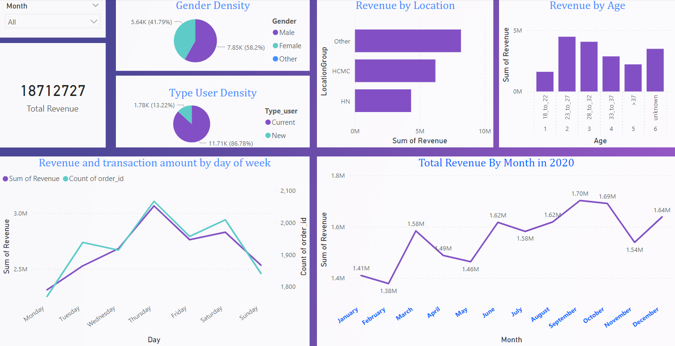
Part B: Q5: Performance Dashboard
Performance tracking-dashboard by months using PowerBI to visualize
File is attached in submission: MoMo Talent 2024_DA_Case Study Visualization.pbix
MoMo Talent 2024_DA_Case Study Visualization.pdf

Slide 6
Part C: Analysis & Business Insights
(10 points)

Slide 7
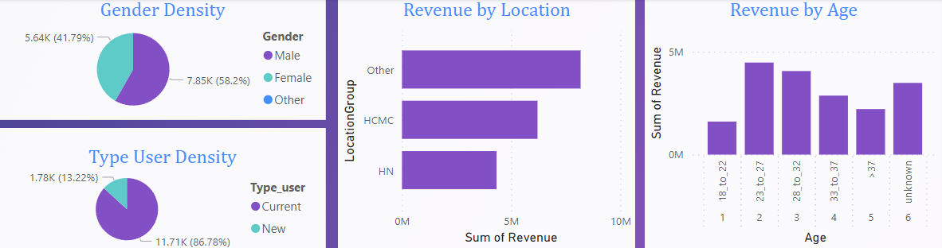
Part C: Q6
Observations and insights about user demographics
Male users have higher density in among gender in a year. Other gender are insignificant -> Male tend to use Topup services more than Female and Other.
Current users have higher density compare to New users in a year -> The vast number of users return to use MOMO Topup services (~ 86.78% - over 3 quarters) which show that users do like to use the services.
Ho Chi Minh City (HCMC) and Ha Noi (HN) are 2 main location from where users mostly use Topup services as those are 2 large and most developed city in the country -> The more user can approach the technology like online transaction, online services the more to attract users to use the Topup services.
The user age is mainly from working age (from 23 to 37) make it easy to understand that users work relate to mobile phone will tend to use the Topup services -> Elder and young users have no significant necessity in using services.

Slide 8
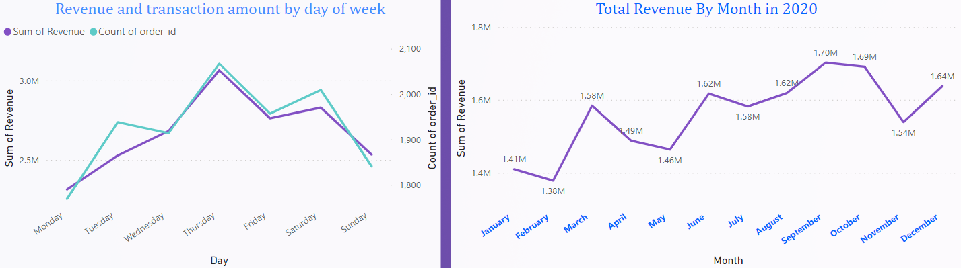
Part C: Q6
Observations and insights about transaction behavior
Highest transactions mainly occur on weekends (Thursday to Saturday) and the amounts of transaction positively correlated changes with total revenues.
Total revenue in 2020 tends to increase by month and rise significantly in September with highest revenue (~1.7 million VNĐ) -> shows that vast amounts of the current users still using the services and the services still attract new users to the Topup services.

Slide 9
Part C: Q7
Suggest for the Marketing promotion campaigns
Promotion campaigns depend on factors to achieve higher performance:
Demographics: + Users file: add or increase the cashback rate to the new users when create/make first transaction in Topup which affect mostly users from age 18 to 22 (18_to_22) and over 37 (>37). Basically, working-age users from (23 to 37) already find the Topup beneficial and good. So the more new users the more they remain using services -> Increase performance.
+ Location: besides Ha Noi and Ho Chi Minh City, increase promotion program in locations where online transaction services are not popular.
Transaction behaviour: Even the trend is increase but there are still down gaps in several months (February, May, November) -> apply seasonal promotion like: higher cashback rate, make Topup transaction to exchange e-voucher,…

Slide 10
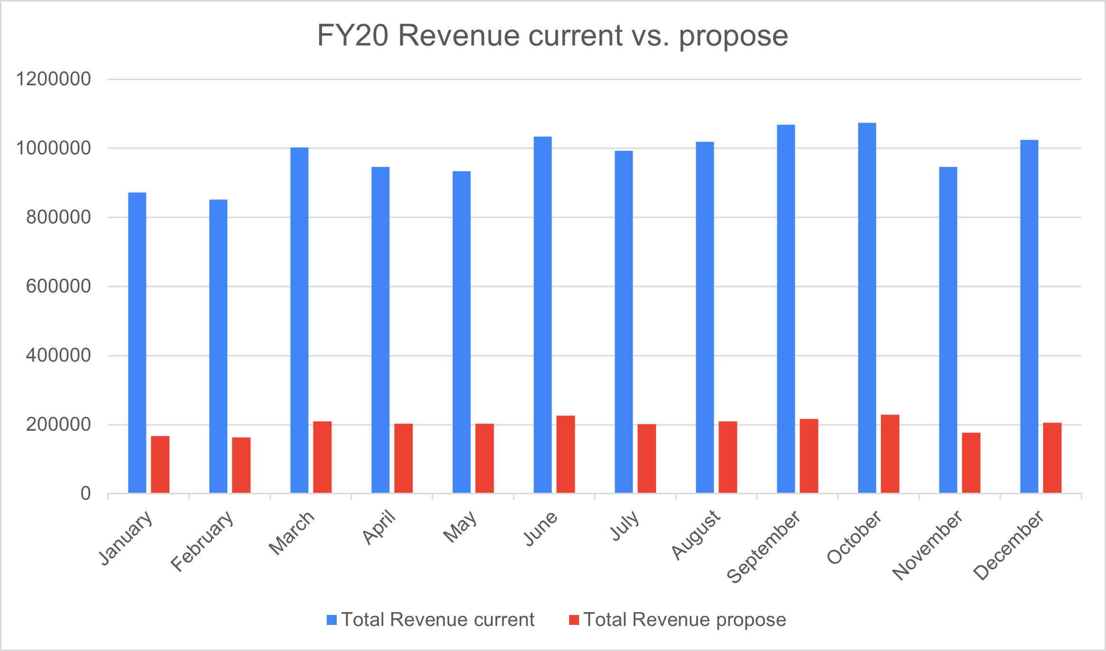
Part C: Q8
Compare revenue after applying current and propose cashback
From chart, total revenue applying current cash-back rate outperform the total revenue applying proposal cash-back rate.
Which can allow Momo development team to lower the total revenue business objective to have more customer cash-back.
Attract more Topup users.

Slide 11
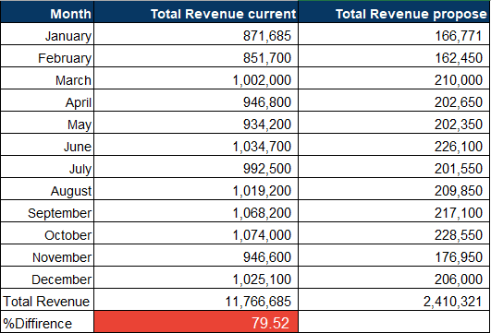
Part C: Q8
S
Compare revenue after applying current and propose cashback
In contrast, applying proposal cash-back for users strongly reduced in total revenue ~80%.
-> Result in a loss of most revenue in years cannot be a wise-choice

Slide 12
Part C: Q9
Topup development strategy suggestion for MoMo
Domain expansion:
Topup do success in transaction service as the total revenue line chart has proved and the density of user type have shown.
Expand the services not only for Telecom services but also in various domain like in-game microtransaction, bill payment with the same strategy.
Retail partnership:
Collaborate with retail stores and online platforms which offering MoMo users discounts or cashback on any purchases whenever users interact retails via MoMo Application.
Topup appearance recognition:
As the data tell that most of users (over 3 quarters) continue using MoMo Topup services but total revenue still not impressive. Increasing services recognition by advertising services, banners collaboration with partners, seasonal events, etc…
Attract new users first time experience with gift and develop Topup customer service for current users may increase in revenue.

